Slide 1

RL project-flappy bird based on
Q-learning and NEAT
PRESENTATION
Group 2

Slide 2
CATALOG
01
RL elements and policy
02
Q-learning Project
Fundamental features about the game
Code and analysis based on q-learning
03
NEAT project
04
Result analysis and comparison
Neuro-evolution of Augmenting Topologies
A better way to train the agent?

Slide 3
01
RL elements and policy
Fundamental features about the game

Slide 4
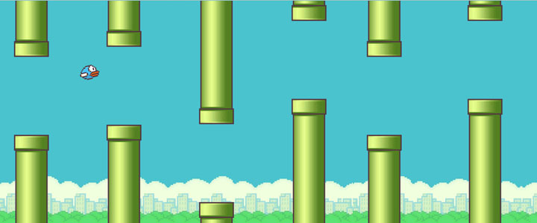
About the game:
There is a flying bird in the game. It will encounter obstacles in the pipeline during the flight. Players need to control the bird to fly upwards. During the flight, they cannot fall to the ground or touch the obstacles. If they continue to perform actions, they will fly higher and higher; if not, it will descend quickly.

Slide 5
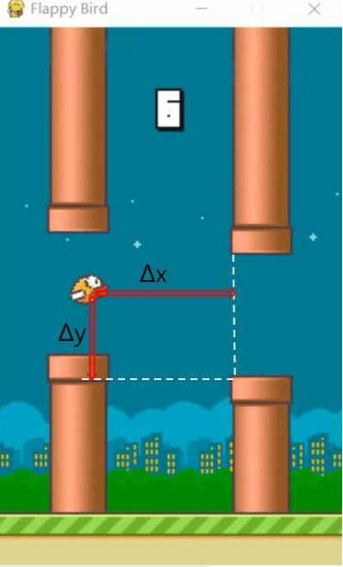
STATE
State space
Specific implementation method
Each horizontal distance and vertical distance form a two-tuple, which can show the state of the agent

Slide 6
Action and Reward
Jump or not jump
Reward
If in a certain state, the agent chooses to jump and give the bird an upward speed.
Without jumping, the bird will fall at a constant acceleration with gravity.
Our idea is to add 1 point to the score of the bird if the bird does not die after each status update, and deduct many points if the bird dies.

Slide 7
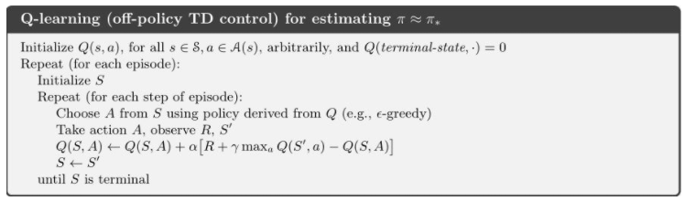
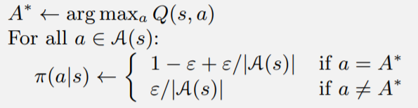
How to find the optimal policy

Slide 8
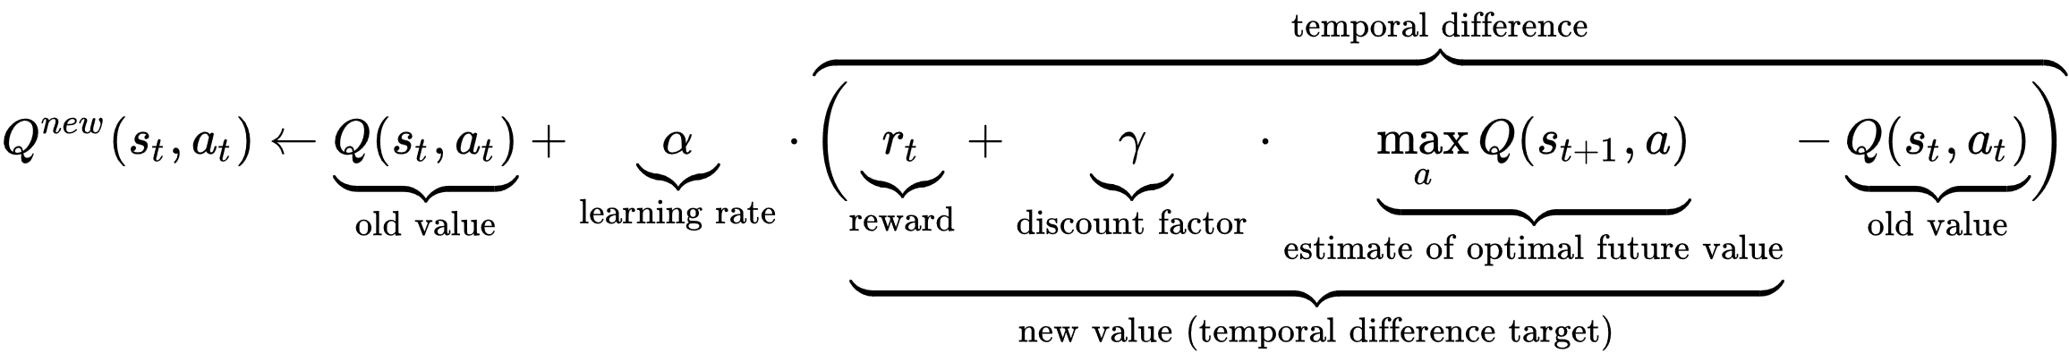
Some explanations about the parameters:
The learning rate (0~1) or step size determines to what extent newly acquired information overrides old information.
The discount factor (0~1) determines the importance of future rewards.

Slide 9
02
Q-learning Project
Flappy Bird Based On Q-learning

Slide 10
Project modules
01
flappy.py
02
algorithms.py
its role is to design an environment that the agent interacting with.
its role is to update each value of the Q-table until it reaches the convergence state.
03
evaluate_bird.py
04
test.py
it's a training process,circulating thousands of episodes to get the final Q-table.Besides,it needs to record the score of each episodes and count the average score in every series to show the training result in form of a line chart.
it's finally pickaged game,
which uses the final Q-table as agent's policy.

Slide 11
Module:flappy.py
class:FlappyBird
FPS
_LIST
score
deltax/delty
playerx/playery
num_states
num_actions
lowerPipes
crashTest
SCREENWIDTH/SCREENHIGHT
pipeVelX
playerVelY
lookup()
reset()
next()
init()
is_terminal()
main()

Slide 12
Module: Algorithms.py
Func:q-learning()
flappy.py
initialize
state0
evn.reset()
policy
ε-greedy()
loop
evn.is_terminal()
s',r=evn.next()
NO
a=choose_from_policy()

Slide 13
Module: evaluate_bird.py
algorithms.py
result.png
Func:evaluate_learning()
final Q-table
initialize
series_size
num_series
gamma
YES
loop
Func:q_learning()
alpha
episode<series_size*num_series
Q-table
epsilon
save.npy

Slide 14
Result analysis
test.py: use the trained Q-table to play the game in an episode, the result is
as following figure shown:
所有省份可任意编辑
您的内容打在这里，或者通过复制您的文本后，在此框中选择粘贴，并选择只保留文字。您的内容打在这里，或者通过复制您的文本后，在此框中选择粘贴，并选择只保留文字。
您的内容打在这里，或者通过复制您的文本后，在此框中选择粘贴，并选择只保留文字。
After 5000 times training the brid can already get very high score and it can survive to the ·end of the game interface width.

Slide 15
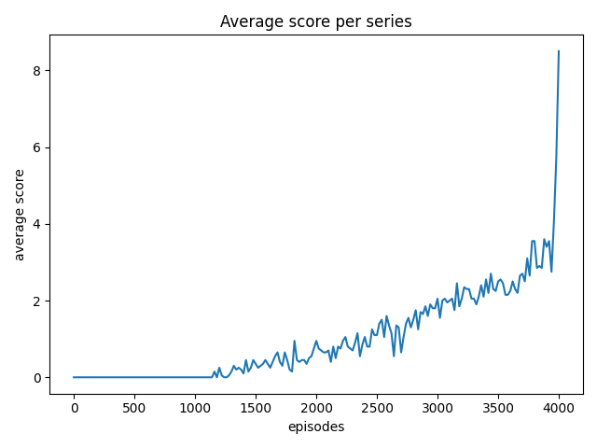
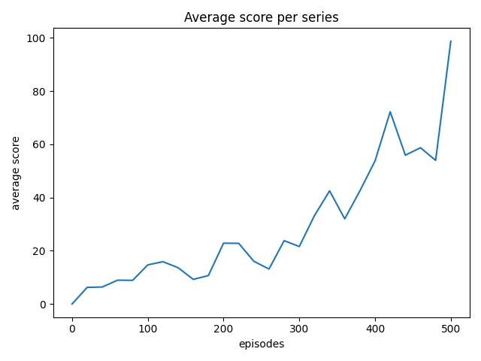
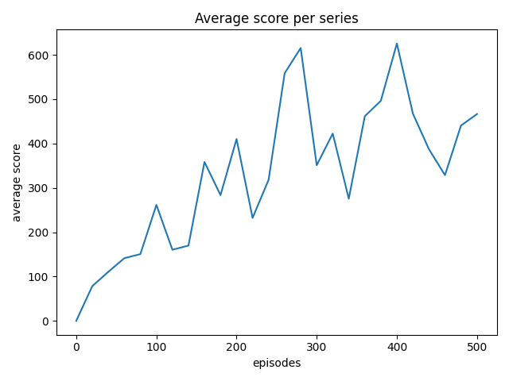
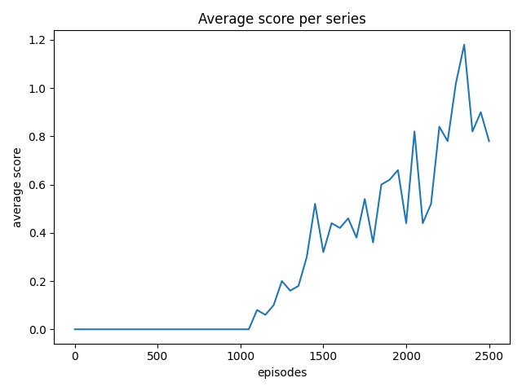
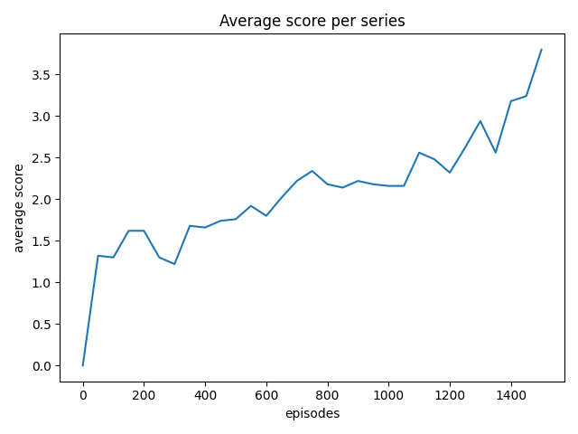
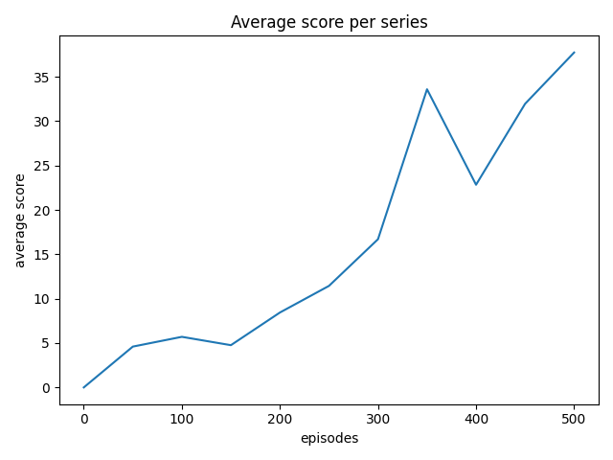
Result analysis
GAPSIZE=150 PIPEVELX=-4
GAPSIZE=100 PIPEVELX=-4

Slide 16
Result analysis
Compared with playing games manually, the scores of people playing games show randomness,and people have advantage in the begining,but AI can get higher score by training constanty.

Slide 17
03
NEAT project
Neuro-evolution of Augmenting Topologies

Slide 18
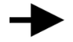
NEAT
NeuroEvolution of Augmenting Topologies (NEAT) :
A genetic algorithm for the generation of evolving artificial neural networks.
Many individuals.
Compete, eliminate, reproduce ,mutate.
(selection) (crossover) (mutation).
generation i
generation i+1

Slide 19

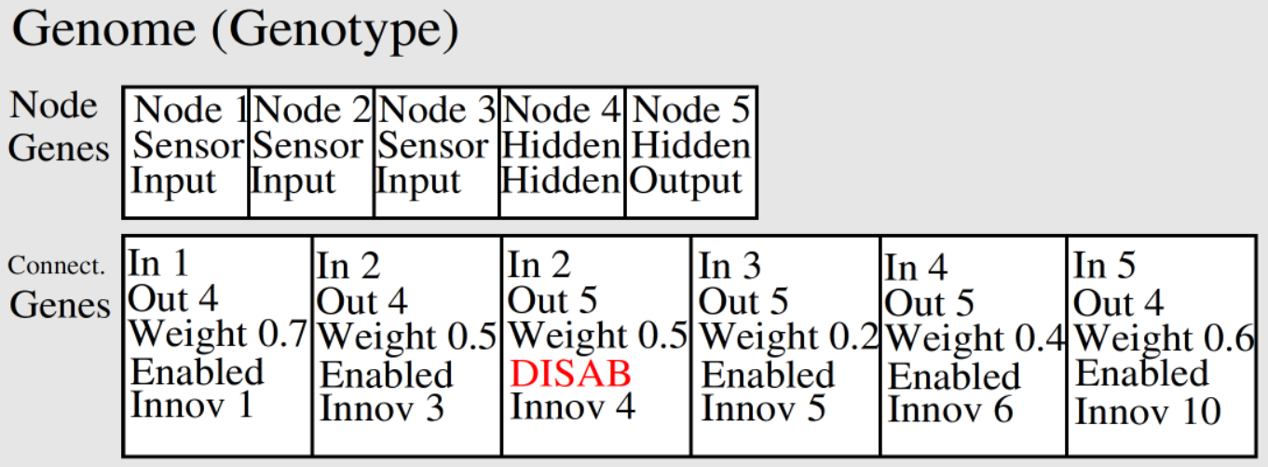
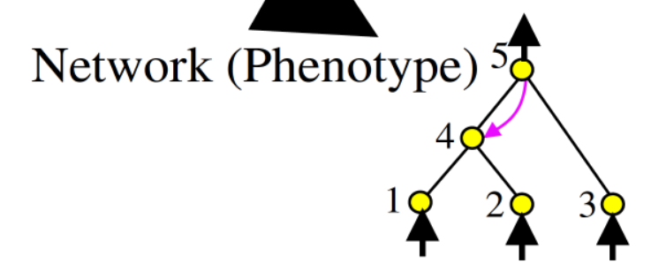
NEAT
Combining genetic algorithm with neural network.
Neural network
Genome

Slide 20
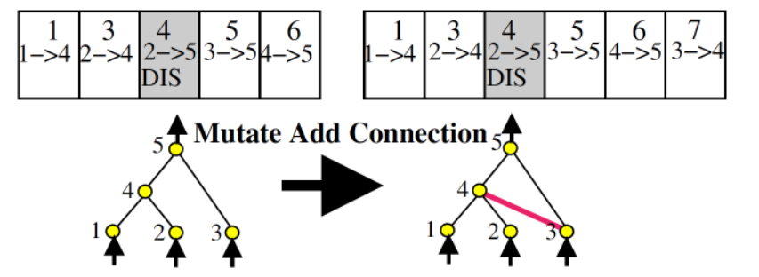
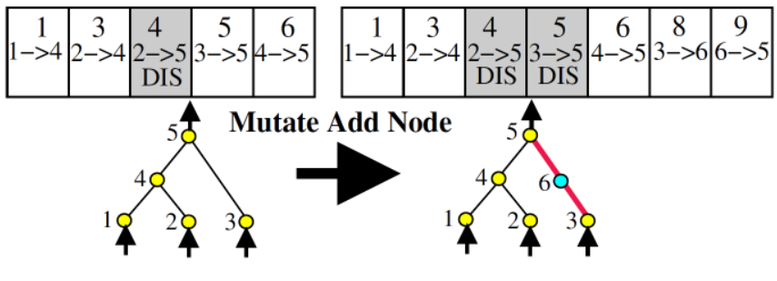
Mutation
There are 3 ways for mutation.
adding or deleting a node.
adding or deleting a connection.
changing weight within a certain range.
One more disabled record.

Slide 21
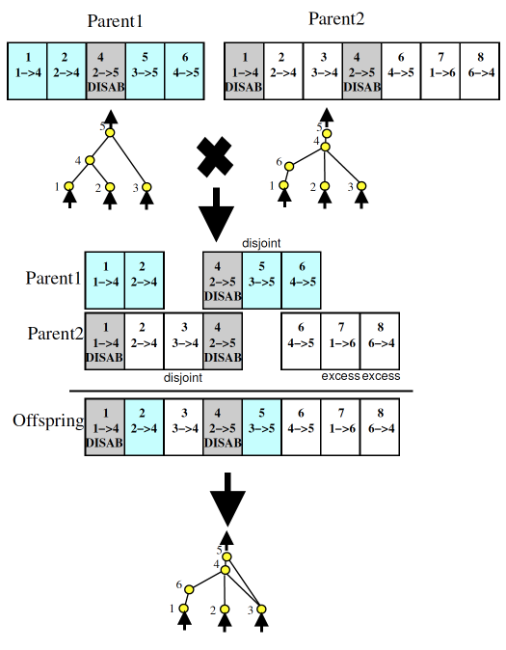

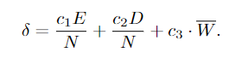
Crossover
Reproduction----crossover
Aligned by innovation ID.
Randomly selected at the same location.
Disjoint genes:
The other parent has the node but not the connection.
Excess genes:
The other parent does not have the node.
compatibility distance δ

Slide 22
Protecting Innovation with Speciation
（potential ↑ fitness ↓)
Problem:
new
δ :
Compete within species:

Slide 23
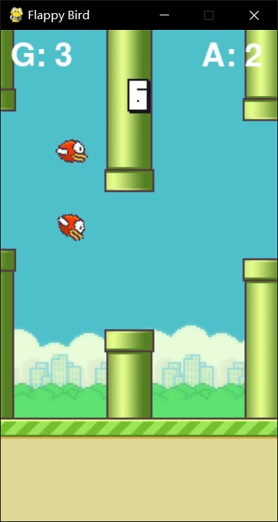
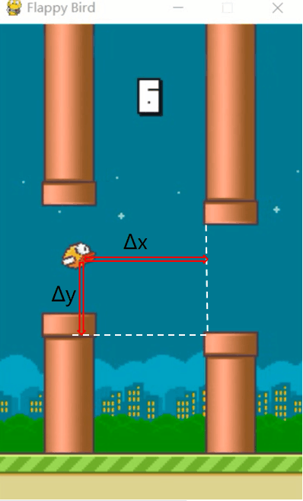
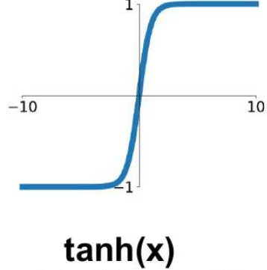
How do I apply the NEAT
>0.5: jump
x
T
A
L
b
bias
<0.5: not jump

Slide 24
How do I apply the NEAT
may change
Best

Slide 25
System
Visualization module
NEAT module
Class: Bird
Class: Pipe
Class: Base
Func: …
Configuration.txt
Func: evaluate_genomes
Func: run

Slide 26
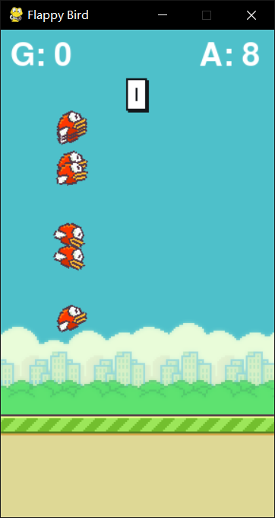
Func: evaluate_genomes
input
Mian of game
convert
Genome list
net list
decide
Bird list
Pipe list
Base
Reward = fitness of genome = score*10
output
Genome.fitness

Slide 27
Func: run
Configuration.txt
initialize
Genome list
loop
NEAT
Visualization
Func: evaluate_genomes

Slide 28
Neat and Visualization
Configuration.txt
initialize
Genome list
loop
NEAT
Visualization
Func: evaluate_genomes

Slide 33
RL project flappy bird based on
Q-learning and NEAT
PRESENTATION
Group 2

Slide 34
CATALOG
01
RL elements
02
Optimal policy
Extract features based on the game itself
How to find the optimal policy
03
NEAT
04
….
….
….

Slide 35
01
RL elements
Extract features based on the game itself

Slide 36
STATE
State space
Too many states?
The horizontal distance of the bird from the next pipe.
The vertical distance of the bird from the next pipe.
Birds die or live.
We know that every time the bird or pipe moves, it is not every time the coordinates + 1 or -1, but + 4 or – 4, which will greatly reduce the number of states.
We consider that not every frame is detected to reduce the amount of computation.
We consider discretizing the distance. This will be a subsequent optimization of our original version.

Slide 37
Action and Reward
Reward
Jump or not jump
If in a certain state, the agent chooses to jump and give the bird an upward speed.
Without jumping, the bird will fall at a constant acceleration with gravity.
We have two schemes.
One is to add 1 point to the score of the bird if the bird does not die after each status update, and deduct many points if the bird dies. Another option is to give a score after the bird dies. The score is the number of tubes the bird passes through.
We think that the first scheme updates the reward immediately, but it may have high computational complexity, and the second scheme delays updating the reward, which may take a long time to train.

Slide 38
Action and Reward
Reward
Jump or not jump
If in a certain state, the agent chooses to jump and give the bird an upward speed.
Without jumping, the bird will fall at a constant acceleration with gravity.
We have two schemes.
One is to add 1 point to the score of the bird if the bird does not die after each status update, and deduct many points if the bird dies. Another option is to give a score after the bird dies. The score is the number of tubes the bird passes through.
We think that the first scheme updates the reward immediately, but it may have high computational complexity, and the second scheme delays updating the reward, which may take a long time to train.

Slide 39
How to find the optimal policy
Each time an action is taken, a new status and reward will be generated. Update the q-table according to the following formula, and then select the action according to the updated q-table next time. In qlearning, each action is selected according to a greedy policy

Slide 40
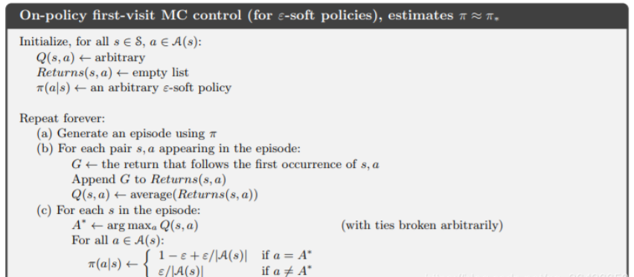
How to find the optimal policy
We assume that ε- Soft policies to determine policy

Slide 41
How to find the optimal
01
02
输入相关标题
这里输入简单的文字概述这里输入简单文字概述简单的文字概述这里输入简单的文字概述这里输入
这里输入简单的文字概述这里输入简单文字概述简单的文字概述这里输入简单的文字概述这里输入
03
输入相关标题
04
输入相关标题
这里输入简单的文字概述这里输入简单文字概述简单的文字概述这里输入简单的文字概述这里输入
这里输入简单的文字概述这里输入简单文字概述简单的文字概述这里输入简单的文字概述这里输入

Slide 42
03
NEAT project
NeuroEvolution of Augmenting Topologies

Slide 43
NEAT
NeuroEvolution of Augmenting Topologies (NEAT) :
A genetic algorithm for the generation of evolving artificial neural networks.
Many individuals.
Compete, eliminate, reproduce ,mutate.
(selection) (crossover) (mutation).
generation i
generation i+1

Slide 44
NEAT
Combining genetic algorithm with neural network.
Neural network
Genome

Slide 45
Mutation
There are 3 ways for mutation.
adding or deleting a node.
adding or deleting a connection.
changing weight within a certain range.
One more disabled record.

Slide 46
Crossover
Reproduction----crossover
Aligned by innovation ID.
Randomly selected at the same location.
Disjoint genes:
The other parent has the node but not the connection.
Excess genes:
The other parent does not have the node.
compatibility distance δ

Slide 47
Protecting Innovation with Speciation
（potential ↑ fitness ↓)
Problem:
new
δ :
Compete within species:

Slide 48
How do I apply the NEAT
>0.5: jump
x
T
A
L
b
bias
<0.5: not jump

Slide 49
How do I apply the NEAT
may change
Best

Slide 50
System
Visualization module
NEAT module
Class: Bird
Class: Pipe
Class: Base
Func: …
Configuration.txt
Func: evaluate_genomes
Func: run

Slide 51
Func: evaluate_genomes
input
Mian of game
convert
Genome list
net list
decide
Bird list
Pipe list
Base
Reward = fitness of genome = score*10
output
Genome.fitness

Slide 52
Func: run
Configuration.txt
initialize
Genome list
loop
NEAT
Visualization
Func: evaluate_genomes

Slide 53
Neat and Visualization
Configuration.txt
initialize
Genome list
loop
NEAT
Visualization
Func: evaluate_genomes

Slide 54
04
NEAT project
NeuroEvolution of Augmenting Topologies

Slide 55
Crossover
Reproduction----crossover
Aligned by innovation ID.
Randomly selected at the same location.
Disjoint genes:
The other parent has the node but not the connection.
Excess genes:
The other parent does not have the node.

Slide 56
NEAT
NeuroEvolution of Augmenting Topologies (NEAT) is a genetic algorithm (GA) for the generation of evolving artificial neural networks.
Each genome includes two gene sets to describe how to establish an artificial neural network.
Node genes: it uniquely represents a specific single neuron.
Connect genes: it uniquely represents a single connection between specific neurons.
Key points
The innovation ID is used to directly code the nodes and connections of the neural network.
The offsprings are generated through crossover according to the innovation ID.
There are gene mutations in connections and nodes
Protecting innovation through speciation.
The initialized neural network has only input and output nodes in order to make the neural network evolve from the simplest network.

Slide 57
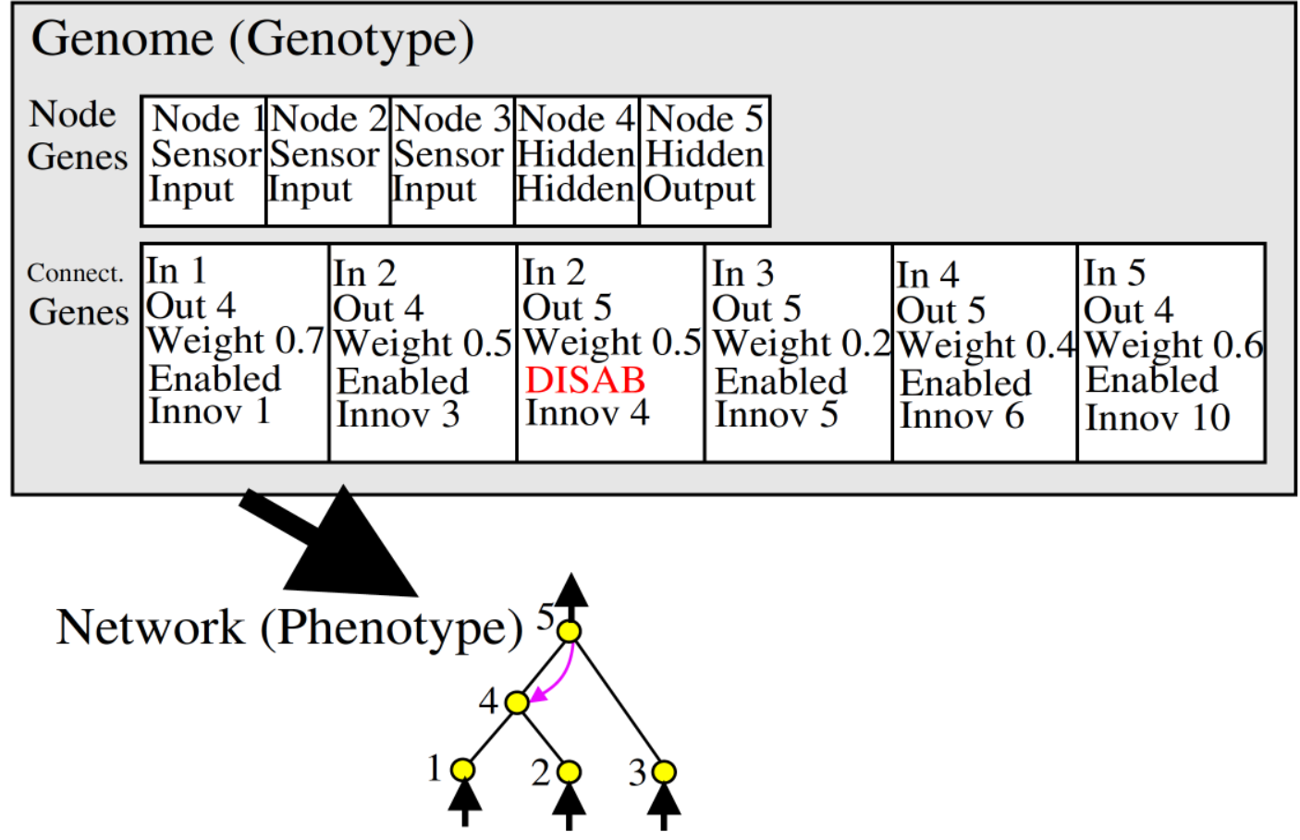
How do I apply the near algorithm
The figure shows how to represent the neural network through the genome.
Node genes is the definition of each node of the neural network. It points out the node is an input, output or hidden node.
Connect genes indicates the connection information between nodes including what nodes are associated, the weight, whether the connection is enabled or not and the exclusive innovation ID.

Slide 58
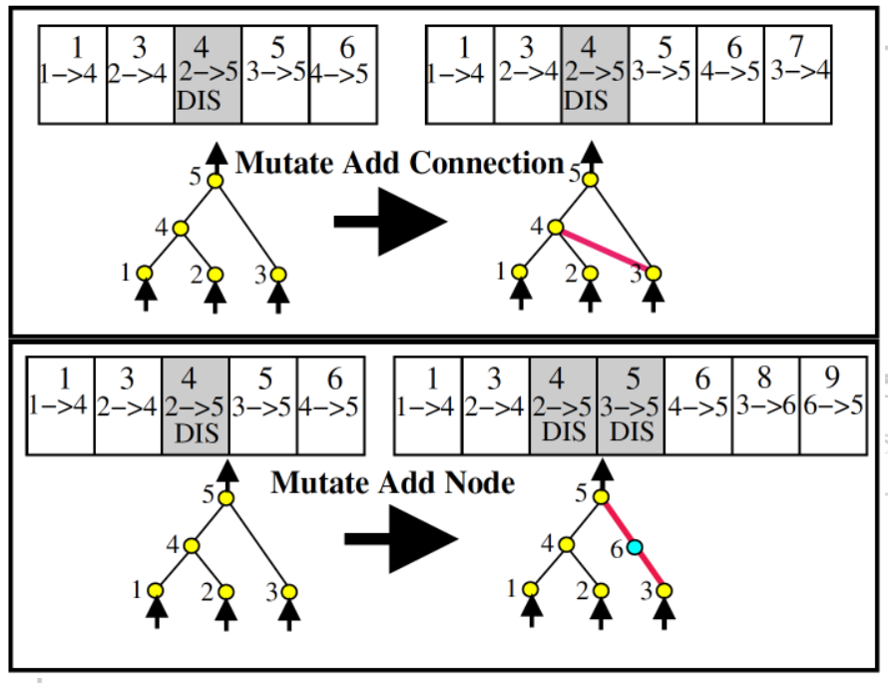
How to mutate
Two ways：Mutation adds node or connection.
If a mutation node is added to the original connection, the original connection will be disabled.

Slide 59
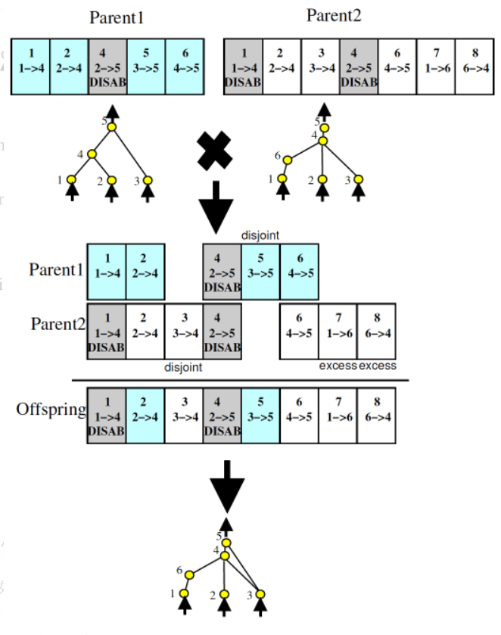
How to mutate and crossover
Two ways to mutate: add node or connection.
Crossover aligns the genes of parents according to innov ID and inherits them. If there are differences between the two sides in the same position, choose at random.
Notes:
If a mutation node is added to the original connection, the original connection will be disabled.

Slide 60
NeuroEvolution of Augmenting Topologies (NEAT) is a genetic algorithm (GA) for the generation of evolving artificial neural networks
01
02
03
04
添加标题
添加标题
添加标题
添加标题
完成模高和
图高的作业
争取尽快做
好不能再拖
辅助软件可以
为幻灯片提供
很好的辅助等
有必要去学习
形成思路风格
仔细考量细节
把每一步做好
这是并列关系
的表达方式之
你可以输入其
他的内容代替

Slide 61
单击添加文字标题
输入小标题
在此处输入文字对自己/公司所需人才的基本特征进行介绍。
输入小标题
在此处输入文字对自己/公司所需人才的基本特征进行介绍。
输入小标题
在此处输入文字对自己/公司所需人才的基本特征进行介绍。

Slide 62
单击添加文字标题
38%
76%
点击输入标题
点击输入本栏的具体文字，简明扼要的说明分项内容，请根据您的具体内容酌情修改。
86%
点击输入标题
点击输入本栏的具体文字，简明扼要的说明分项内容，请根据您的具体内容酌情修改。
点击输入标题
53%
点击输入本栏的具体文字，简明扼要的说明分项内容，请根据您的具体内容酌情修改。
点击输入标题
点击输入本栏的具体文字，简明扼要的说明分项内容，请根据您的具体内容酌情修改。

Slide 63
单击添加文字标题
输入文字信息
输入文字信息
输入文字信息
输入文字信息

Slide 64
02
单击添加文字标题
templateBusiness end of year job summary
general PPT template

Slide 65
单击添加文字标题
在此输入酷炫文字
在此输入酷炫文字
输入相关文字
输入相关文字
在此输入酷炫文字
在此输入酷炫文字
输入相关文字
输入相关文字

Slide 66
单击添加文字标题
单击此处添加文本1
单击此处添加文本1 此处添加文本 此处添加文本 此处添加文本 此处添加文本 此处添加文本 此处添加文本 此处添加文本
单击此处添加文本2
单击此处添加文本3

Slide 67
单击添加文字标题
输入标题
输入标题
输入标题
这里输入简单的文字概述这里输入简单
这里输入简单的文字概述这里输入简单
这里输入简单的文字概述这里输入简单
2014
2021
2013
2015
20XX
输入标题
输入标题
这里输入简单的文字概述这里输入简单
这里输入简单的文字概述这里输入简单

Slide 68
单击添加文字标题
输入文字信息输入文字信息
输入文字信息
输入文字信息
输入文字信息
输入文字信息输入文字信息
输入文字信息
输入文字信息
输入文字信息
输入文字信息输入文字信息
输入文字信息
输入文字信息
输入文字信息
输入文字信息输入文字信息
输入文字信息
输入文字信息
输入文字信息

Slide 69
单击添加文字标题
所有省份可任意编辑
您的内容打在这里，或者通过复制您的文本后，在此框中选择粘贴，并选择只保留文字。您的内容打在这里，或者通过复制您的文本后，在此框中选择粘贴，并选择只保留文字。
您的内容打在这里，或者通过复制您的文本后，在此框中选择粘贴，并选择只保留文字。
点击添加文本
点击添加文本
点击添加文本
点击添加文本

Slide 70
03
单击添加文字标题
templateBusiness end of year job summary
general PPT template

Slide 71
单击添加文字标题
73%
87%
35%
36%
$96,453
$46,200
$14,321
$16,567
单击此处添加文本1此处添加文本此处添加文本此处添加文本此处添加文本此处添加文本
单击此处添加文本1此处添加文本此处添加文本此处添加文本此处添加文本此处添加文本
单击此处添加文本1此处添加文本此处添加文本此处添加文本此处添加文本此处添加文本
单击此处添加文本1此处添加文本此处添加文本此处添加文本此处添加文本此处添加文本

Slide 72
单击添加文字标题
单击此处添加标题
单击此处添加标题
单击此处添加标题
单击此处添加标题
单击此处添加标题
单击此处添加段落文本单击此处添加段落文本单击此处添加段落文本单击此处添加段落文本
单击此处添加段落文本单击此处添加段落文本单击此处添加段落文本单击此处添加段落文本
单击此处添加段落文本单击此处添加段落文本单击此处添加段落文本单击此处添加段落文本
单击此处添加段落文本单击此处添加段落文本单击此处添加段落文本单击此处添加段落文本
单击此处添加段落文本单击此处添加段落文本单击此处添加段落文本单击此处添加段落文本
文字
文字
文字
文字
文字

Slide 73
单击添加文字标题
单击此处添加文本，单击此处添加文本
单击此处添加文本，单击此处添加文本
单击此处添加文本，单击此处添加文本
单击此处添加文本，单击此处添加文本

Slide 74
单击添加文字标题
单击此处添加文本单击此处添加文本单击此处添加文本单击此处添加文本
单击此处添加文本单击此处添加文本
添加文本
添加文本
添加文本
添加文本
添加文本
添加文本
添加文本
添加文本
添加文本
添加文本
添加文本
添加文本
单击此处添加文本
单击此处添加文本
单击此处添加文本
单击此处添加文本
单击此处添加文本
单击此处添加文本
文本
文本
文本
请输入您需要的文字
请输入您需要的文字
请输入您需要的文字
请输入您需要的文字
请输入您需要的文字
请输入您需要的文字
请输入您需要的文字
请输入您需要的文字

Slide 75
单击添加文字标题
添加文本
单击此处添加文本，单击此处添加文本，单击此处添加文本，单击此处添加文本。
添加文本
单击此处添加文本，单击此处添加文本，单击此处添加文本，单击此处添加文本。
添加文本
单击此处添加文本，单击此处添加文本，单击此处添加文本，单击此处添加文本。
添加文本
单击此处添加文本，单击此处添加文本，单击此处添加文本，单击此处添加文本。
PPT模板 http://www.1ppt.com/moban/

Slide 76
04
单击添加文字标题
templateBusiness end of year job summary
general PPT template

Slide 77
单击添加文字标题
点击添加标题
点击添加标题
文字是简单的视觉图案再现 口语的声音，因而更加清晰，可以反复阅读，可以突破时间和空间的限制
文字是简单的视觉图案再现 口语的声音，因而更加清晰，可以反复阅读，可以突破时间和空间的限制
点击添加标题
点击添加标题
文字是简单的视觉图案再现 口语的声音，因而更加清晰，可以反复阅读，可以突破时间和空间的限制
文字是简单的视觉图案再现 口语的声音，因而更加清晰，可以反复阅读，可以突破时间和空间的限制

Slide 78
单击添加文字标题
添加标题内容
添加标题内容
添加标题
详写内容……点击输入本栏的具体文字，简明扼要的说明分项内容，此为概念图解，请根据您的具体内容酌情修改
添加标题
详写内容……点击输入本栏的具体文字，简明扼要的说明分项内容，此为概念图解，请根据您的具体内容酌情修改
输入文本内容
输入文本内容
输入文本内容
输入文本内容
添加标题内容
添加标题内容
详写内容……点击输入本栏的具体文字，简明扼要的说明分项内容，此为概念图解，请根据您的具体内容酌情修改
添加标题
详写内容……点击输入本栏的具体文字，简明扼要的说明分项内容，此为概念图解，请根据您的具体内容酌情修改
添加标题

Slide 79
单击添加文字标题
写内容……点击输入本栏的具体文字，简明扼要的说明分项内容，此为概念图解，请根据您的具体内容酌情修改。写内容……点击输入本栏的具体文字，简明扼要的说明分项内容，此为概念图解，请根据您的具体内容酌情修改。写内容……点击输入本栏的具体文字，简明扼要的说明分项内容，此为概念图解，请根据您的具体内容酌情修改。
添加
关键字
添加
关键字
添加
关键字
添加
关键字

Slide 80
汇报完毕 感谢聆听
SUMMARY OF PPT TEMPLATES IN MID YEAR WORK
汇报人:第一PPT 部门:设计部

Slide 81

可以在下列情况使用
个人学习、研究。
拷贝模板中的内容用于其它幻灯片母版中使用。
不可以在以下情况使用
任何形式的在线付费下载。
网络转载、线上线下传播。
PPT模板： www.1ppt.com/moban/ 行业PPT模板：www.1ppt.com/hangye/
节日PPT模板：www.1ppt.com/jieri/ PPT素材： www.1ppt.com/sucai/
PPT背景图片：www.1ppt.com/beijing/ PPT图表： www.1ppt.com/tubiao/
优秀PPT下载：www.1ppt.com/xiazai/ PPT教程： www.1ppt.com/powerpoint/
Word模板： www.1ppt.com/word/ Excel模板： www.1ppt.com/excel/
个人简历： www.1ppt.com/jianli/ PPT课件： www.1ppt.com/kejian/
手抄报： www.1ppt.com/shouchaobao/ 试题下载： www.1ppt.com/shiti/
教案下载： www.1ppt.com/jiaoan/ 字体下载： www.1ppt.com/ziti/

